Slide 1

无人机航拍场景下的语义三维重建
陈煜1701213988@pku.edu.cn
王尧 wangyao@pku.edu.cn
王旭普 wxp@pku.edu.cn

Slide 2
CONTENTS
PART 1
Introduction
PART 2
Semantic Segmentation
PART 3
Structure from Motion
PART 4
Results Display

Slide 3
Division & Cooperation
Name
Student ID
Work
陈煜
1701213988
稀疏点云模型生成
王尧
1701214012
语义分割
王旭普
1701214013
前端结果展示

Slide 4
Brief Introduction to 3D Reconstruction
Input
raw pictures taken from different views
Output
Point Clouds (Sparse & Dense)
Depth Map
Mesh

Slide 5
Motivation
- Additional semantic information to improve both efficiency and accuracy
- Semantic 3D points to improve the accuracy of semantic segmentation & for automatic semantic segmentation

Slide 6
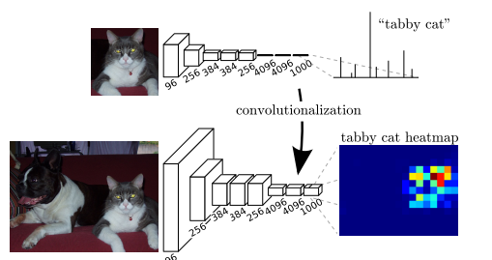
Semantic segmentation
FCN: Transforming fully connected layers into convolution layers

Slide 7
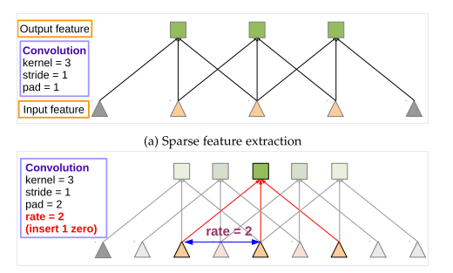
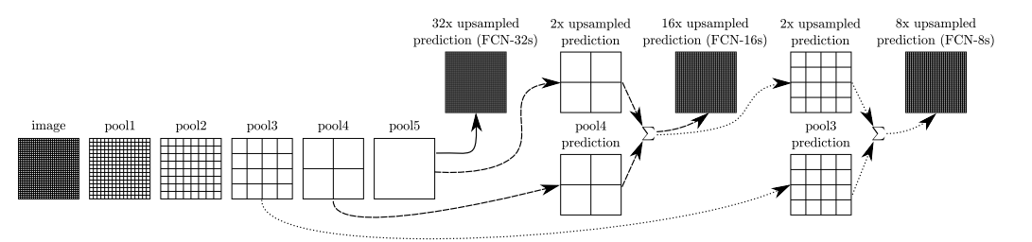
from FCN to Deeplab
问题 | deeplab解决方案
特征图（feature map）分辨率过低 | 膨胀卷积(Atrous convolution)
多尺度物体 | 膨胀金字塔池化(Atrous spatial pyramid pooling )
池化后不能准确反映位置 | 全链接条件随机场(Fully connected CRF)
Atrous(dilated) convolution

Slide 8
Dataset Construction
Data selection
Semantic labeling
Post process
Enrich the variety from different:
Drone height
Light(shadow)
Camera angle
Image content
The labeling pipeline is:
By photo shop
Semi-automatic
5 min per image
The main goals are:
To combine semantic masks into single ground truth label
To deal with multi-labeled/unlabeled pixel
Train_set | Validation _set
156 | 30

Slide 9
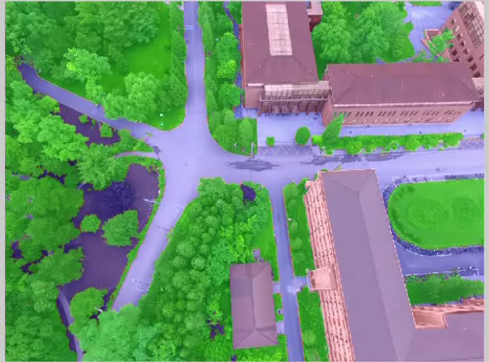
Dataset glimpse

Slide 10
Training
Hyper Parameters
Backbone network | Resnet-101
Crop size | 513*513
Init Learning rate | 1e-4
batch size | 12
Weight decay | exp 0.98
Max epoch | 10
Result
MIoU | 88.7
Mean accuracy | 94.1

Slide 11
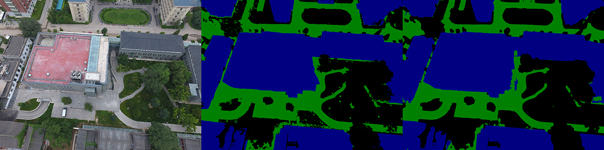
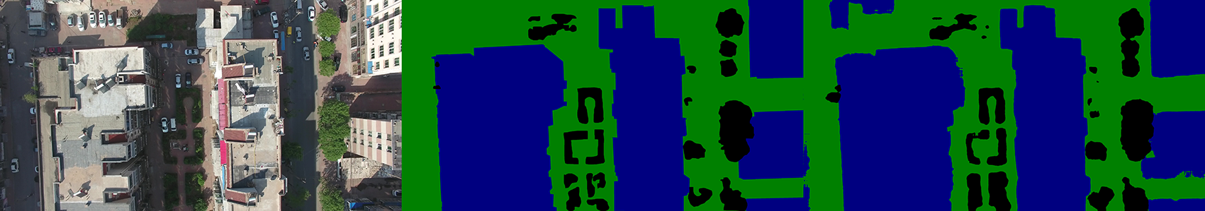
Result
campus
huludao

Slide 12
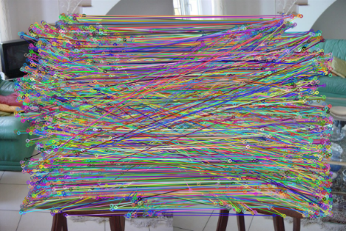
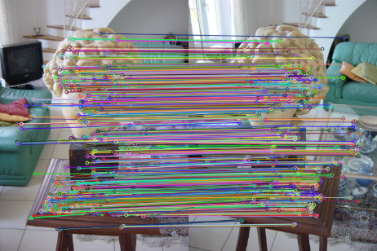

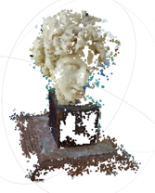
Pipeline for SfM
Pictures
Feature Matching
Geometric Verifying
Initial Pair Selection
Bundle Adjustment
Triangulation
Camera Registeration
sparse model

Slide 13
Semantic Feature Extracts
- SIFT keypoint detector
- Extract semantic label by semantic segmentation result
- Group features by semantic label, then perform feature matching

Slide 14
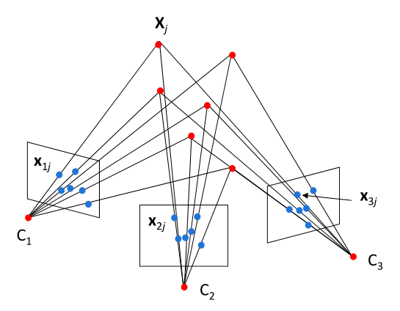
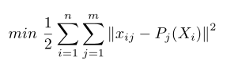
Unonstrained Bundle Adjustment
- Unconstrained Bundle Adjustment
- Solved by Levenburg-Marquart approach

Slide 15
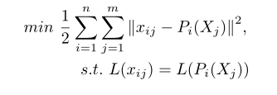
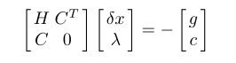
Constrained Bundle Adjustment
- Constrained Bundle Adjustment
- Solved by Sequential Quadratic Programming

Slide 16
Reconstruction Results
Dataset
Views
Original SfM
Semantic SfM
Poses
Points
Tracks
RMSE
Time
Poses
Points
Tracks
RMSE
Time
HU-hall
195
195
476,853
760,769
0.536045
2h 10m 39s
195
473,056
745,969
0.531877
2h 5m 39s
PKU-e33
392
392
559,065
810,390
0.565699
3h 28m 43s
392
554,449
803,395
0.561667
3h 21m 29s
PKU-e44
337
337
468,978
641,171
0.546114
5h 23m 10s
337
469,371
635,279
0.538501
3h 7m 13s
PKU-m1
288
288
422,158
650,072
0.564724
2h 32m 10s
288
420,044
644,405
0.560242
2h 30m 49s
PKU-n1
350
350
479,813
622,243
0.471467
6h 17m 09s
TODO
350
TODO
TODO
TODO
Huludao-n15
248
244
484,229
667,029
0.529639
2h 40m 07s
248
484,915
647,101
0.520202
2h 37m 10s
Black: Normal/Unchanged Value Red: Exception Value Green: Increased Value Blue: Decreased Value

Slide 17
Result Display
使用nodejs搭建一个本地网站进行结果展示
使用multer来处理文件的上传
使用WebGL来处理模型的导入
使用three.js来导入模型，读取模型的点位置
使用PointsMaterial来渲染模型的颜色
使用canvas在web页面展示模型
使用controller来添加模型控制，可以对模型进行旋转平移操作

Slide 18
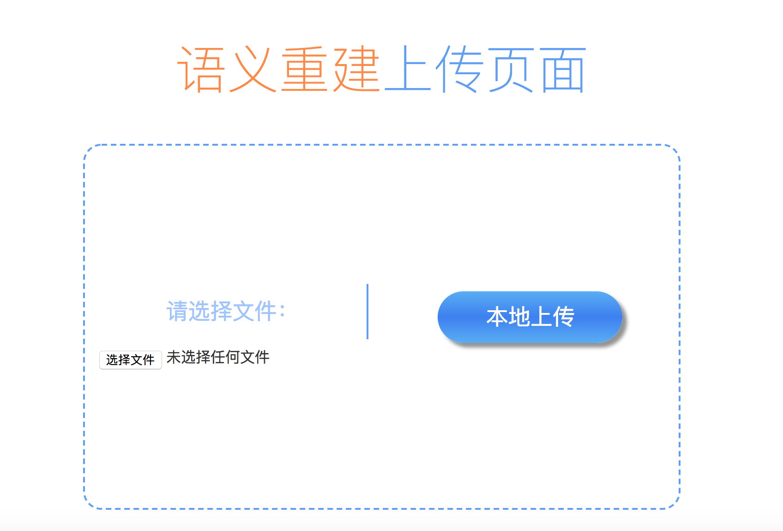
Model Upload

Slide 19
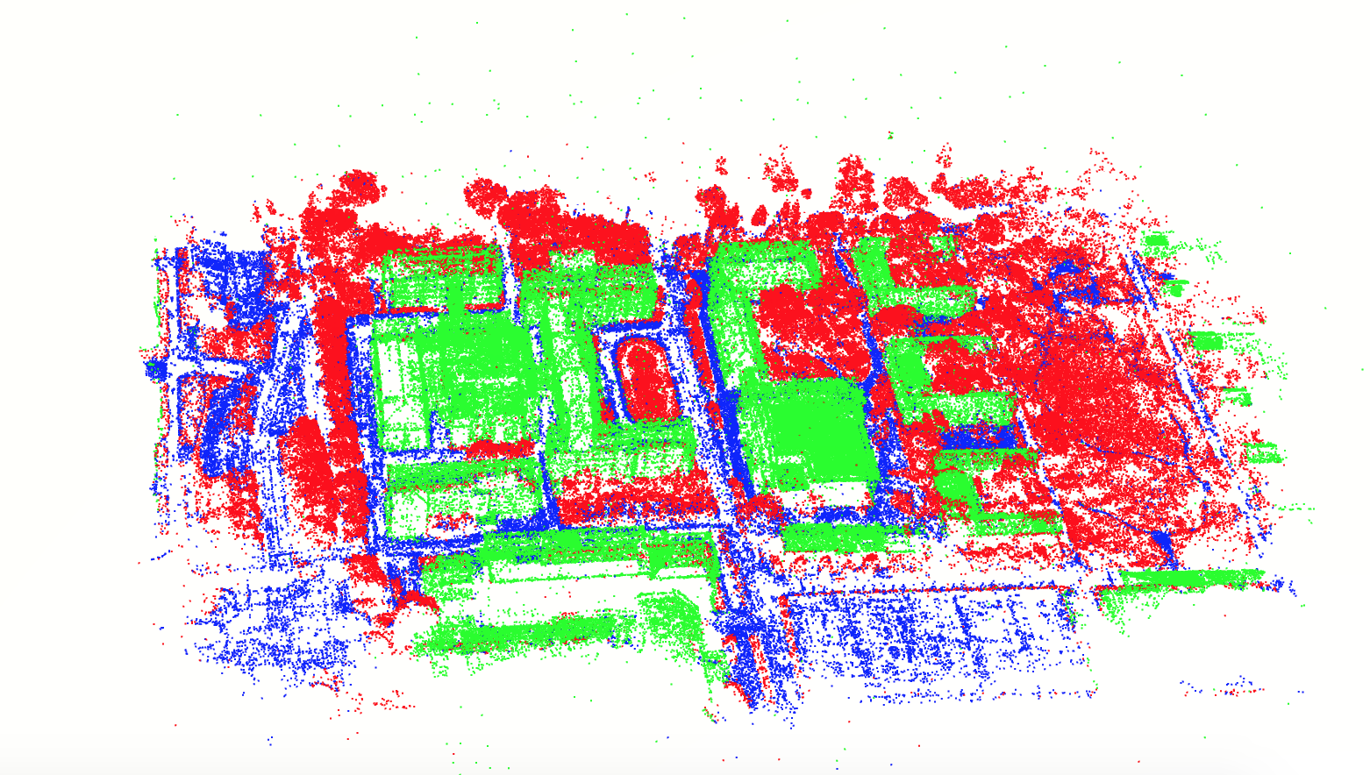
Model Display

Slide 20
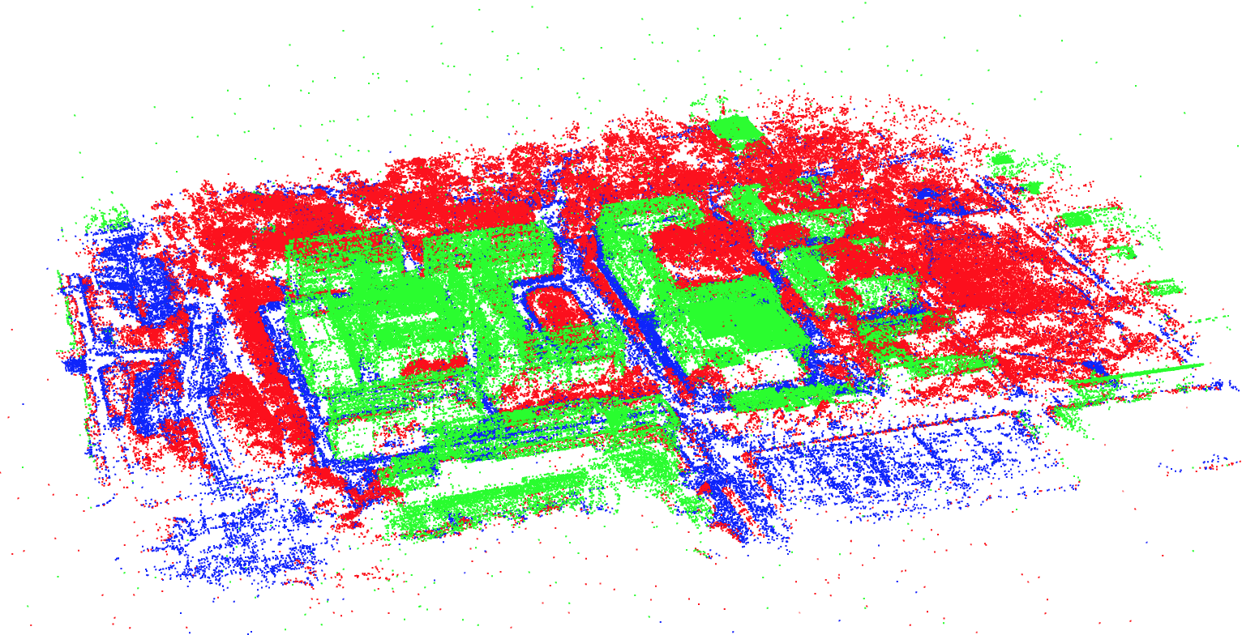
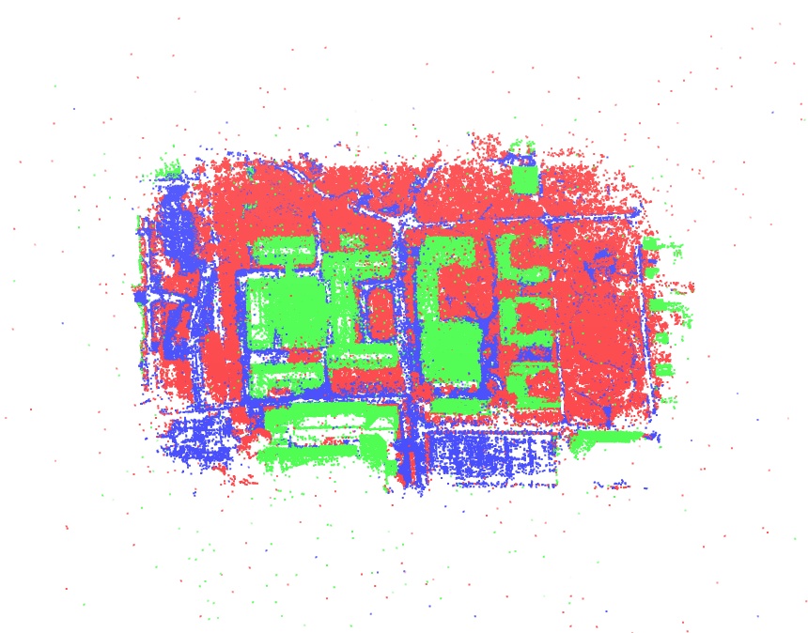
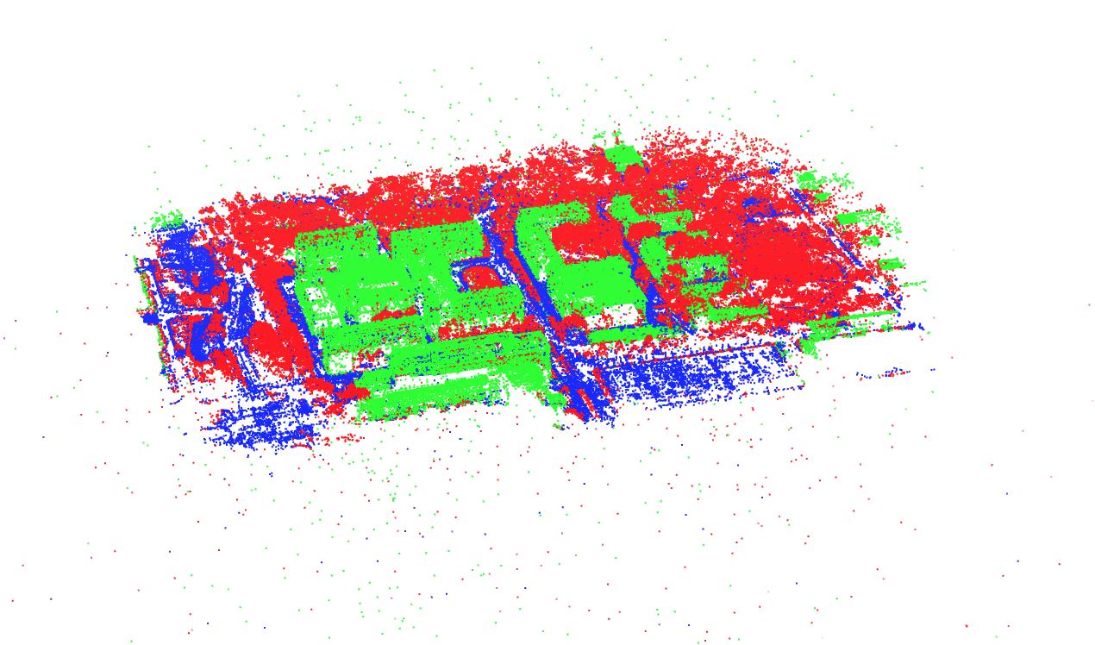
Model Display

Slide 21
Future Work
- Learning semantic features
- Dense reconstruction for automatic semantic segmentation

Slide 22
References
[1] Noah Snavely, Steven M. Seitz, Richard Szeliski. Photo Tourism: Exploring image collections in 3D. ACM Transactions on Graphics (Proceedings of SIGGRAPH 2006), 2006.
[2] Snavely K N. Scene reconstruction and visualization from internet photo collections[M]. University of Washington, 2008.
[3] Schönberger J L, Frahm J M. Structure-from-Motion Revisited[C]// Computer Vision and Pattern Recognition. IEEE, 2016.
Notes:
模板来自于 http://www.ypppt.com

Slide 23
THANKS FOR LISTENING

